Slide 1
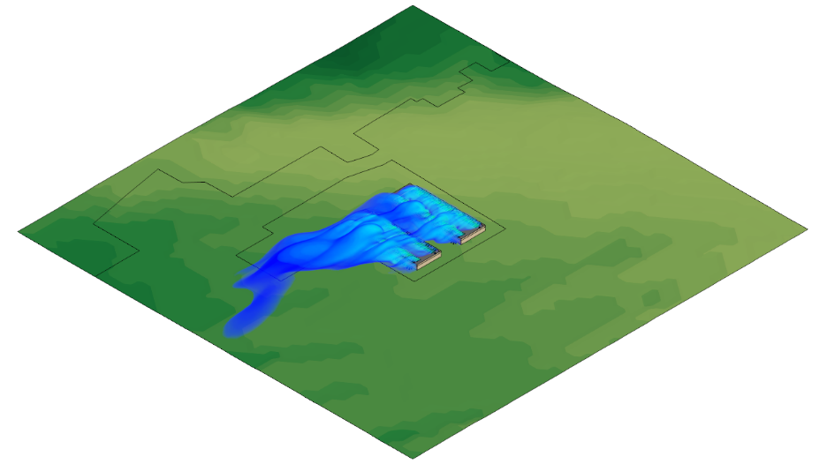
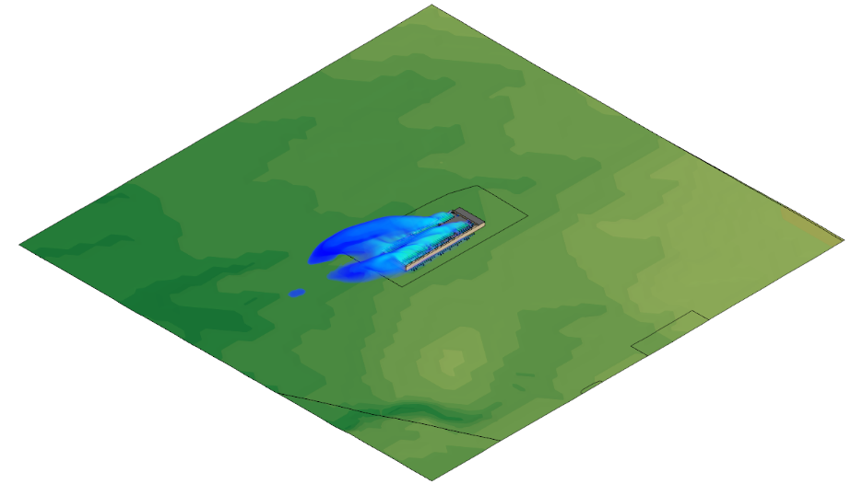

CPL
CFD Wind Dispersion Study of Heated Exhaust From STAMP Data Centers
June 19th, 2026
M/E Reference: 260210.00

Slide 2
Table of Contents
Section 1: Introduction
  Overview of Study
Section 2: Model Parameters
  Wind Direction & Speed Data
  Model Geometry
  Mechanical Information
Section 3: Case Study
  Base Case – North Site: Evaluation of Two Data Centers at Northern STAMP Site
  Base Case – South Site: Evaluation of One Data Center at Southern STAMP Site
Section 4: Analysis & Conclusions

Slide 3
Introduction
Overview of Study
Section
1
Salas O’Brien Consulting and Engineering Group of New York, Inc. (FKA M/E Engineering) has prepared a Computational Fluid Dynamics (CFD) wind dispersion study on behalf of CPL to assess the expected windborne distribution of heated exhaust air as it is released from a selection of equipment proposed to serve three large data centers across two sites (Project Double Reed) located within the Science & Technology Advanced Manufacturing Park (STAMP) site. The STAMP site is located to the east of the Tonawanda Seneca Nation’s Territory and within the town of Alabama, NY
Data centers require substantial cooling capacity to maintain strict interior conditions for the optimal operation of the computational and supporting equipment and so the generated heat from within the space must be migrated and released to the atmosphere
This study aims to assess and respond to comments and concerns related to the project design and its potential effect on the nearby environment regarding elevated temperatures nearby to the data centers, due to the airborne dispersion of their heated exhaust, by simulating the expected distribution of temperature around the modeled data centers
  This study assesses the predicted potential for Project Double Reed to elevate nearby temperatures, if any, and quantify the potential effect on the adjacent Tonawanda Seneca Nation Territory and Town
Two scenario are evaluated:
  Base Case – North Site: Evaluation of heated exhaust released from the two large data centers located at the northern STAMP site under atypical ambient conditions comprising a wind speed of 10 mph and an ambient temperature of 87.2 F
  Base Case – South Site: Evaluation of heated exhaust released from the single large data center located at the southern STAMP site under atypical ambient conditions comprising a wind speed of 10 mph and an ambient temperature of 87.2 F
Display of results:
  Airborne dispersion of heated exhaust air will be displayed as animated volumetric renderings

Slide 4
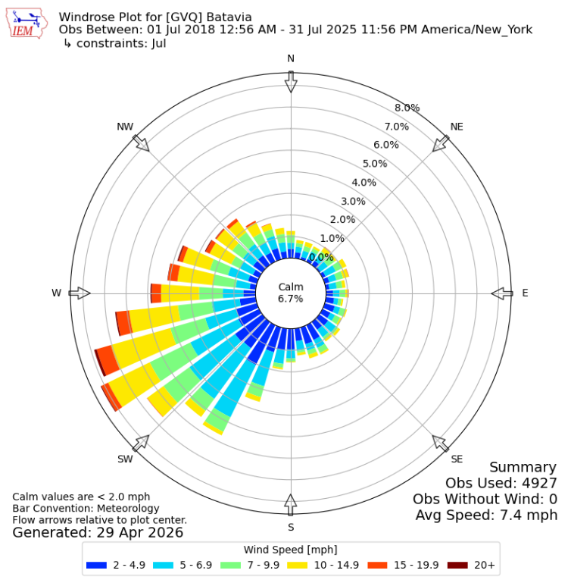
Model Parameters
Wind Direction & Speed Data – July
Section
2
A historical wind rose plot is shown for the STAMP site. The data has been generated between 2018 and 2025 as measured from the Genesee County Airport which is located nearby in Batavia, NY
The different colors shown on the wind rose represent the wind speed ranges for each compass direction. The length of the different color bands indicate the probability of that wind speed at the associated direction
  The longer the color band, the higher the probability of that wind direction based on this historical data
Average July Wind Speed: 7.4 mph
Simulated July Wind Speed: 10 mph
  A wind speed of 10 mph has been simulated to account for periodic gusting
Data Source: http://mesonet.agron.iastate.edu

Slide 5
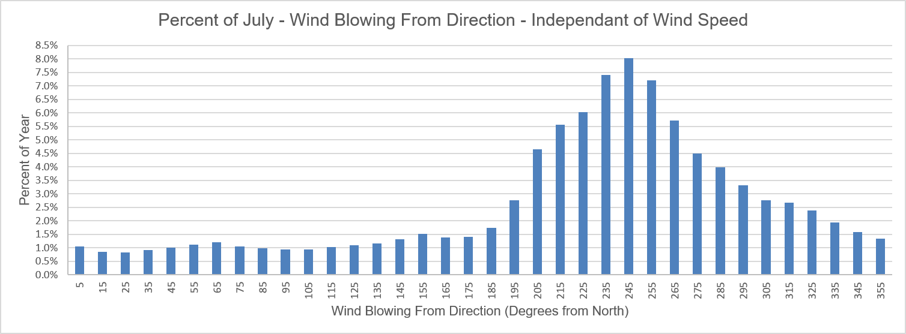
Model Parameters
Wind Direction & Speed Data – July
Section
2
The bar chart below shows the same information as the preceding July wind rose plot, except that the probability of the wind direction here is independent of wind speed and calm days are not included (low wind velocity, therefore no discernable wind direction). The information below indicates that the most frequent wind directions are generally from the south-west. Prevailing winds from this most frequent direction will effectively “push” heated exhaust plumes away from the Tonawanda Seneca Nation throughout the year and across the remainder of the STAMP site
West
North
East
South

Slide 6
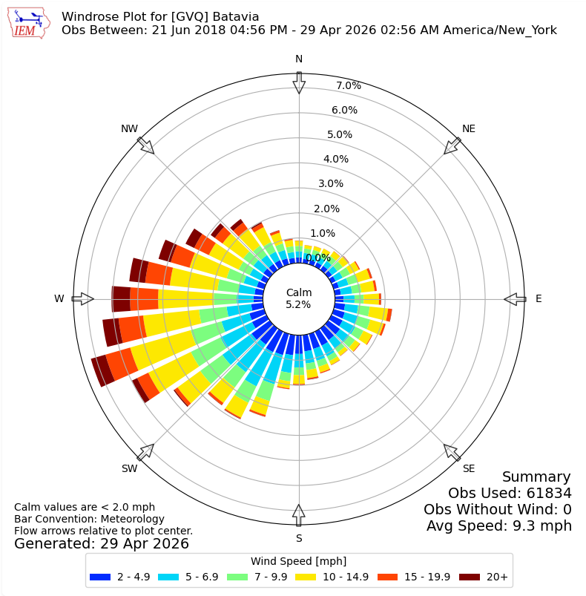
Model Parameters
Wind Direction & Speed Data – Yearly
Section
2
An additional wind rose is also provided which describes the average wind directions over an entire year, and which reinforces that the most frequent prevailing winds will generally carry the exhaust plume away from the Tonawanda Seneca Nation
A July condition was modeled as that month contains the highest average ambient air temperatures which aid to represent a reasonable “worst-case” scenario. The modeled 87.2 °F ambient temperature aligns with the overall mechanical sizing condition and exceeds the ASHRAE 99.6% cooling design condition temperature as measured from the Buffalo Niagara International Airport of 86.6 °F
For a given winter condition, it is expected that the plume buoyancy due to the large temperature difference against the surrounding chilled ambient air will both carry the plume higher into the atmosphere, and would better dilute the overall temperature of the plume
Data Source: http://mesonet.agron.iastate.edu

Slide 7
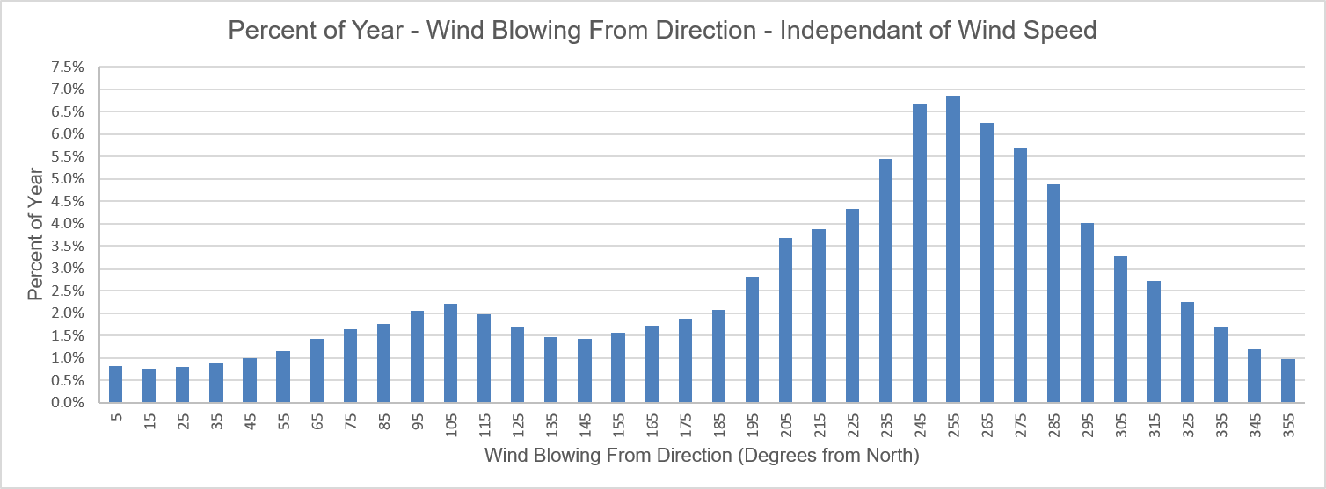
Model Parameters
Wind Direction & Speed Data – Yearly
Section
2
The bar chart below shows the same information as the preceding yearly wind rose plot, except that the probability of the wind direction here is independent of wind speed and calm days are not included (low wind velocity, therefore no discernable wind direction). The information below indicates that the most frequent wind directions continue to generally arrive from the south-west. Prevailing winds from this most frequent direction will effectively “push” heated exhaust plumes away from the Tonawanda Seneca Nation throughout the year
West
East
South
North

Slide 8
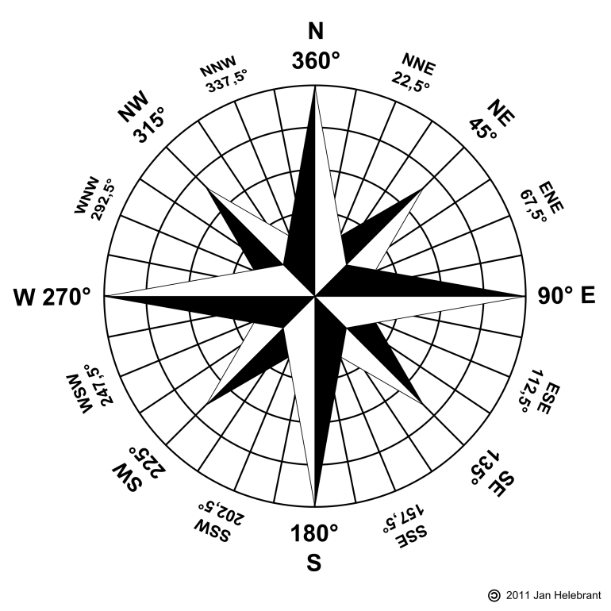
Model Parameters
Wind Direction & Speed Data
Section
2
A wind speed of 10 mph was modelled to partially account for gusting conditions. The wind direction was dynamically changed in thirty-degree increments from 5°(NNE) to 335°(NNW). Each wind direction was maintained for a dwell time of 70 seconds
Shown below is a compass that indicates the wind direction and corresponding wind ‘blowing from’ angle
  For example; NE, 35°, indicates that the wind is blowing from the northeast which is equal to a compass direction of 35°
The remaining un-highlighted space on the compass below indicates that the final wind direction is at 335°, such that if the prevailing winds were indexed once more by 30°, the prevailing wind would return back to its initial starting direction – that being 5° (or 365°)
Yellow area indicates wind directions (in thirty-degree increments) used in the study where wind direction was varied

Slide 9
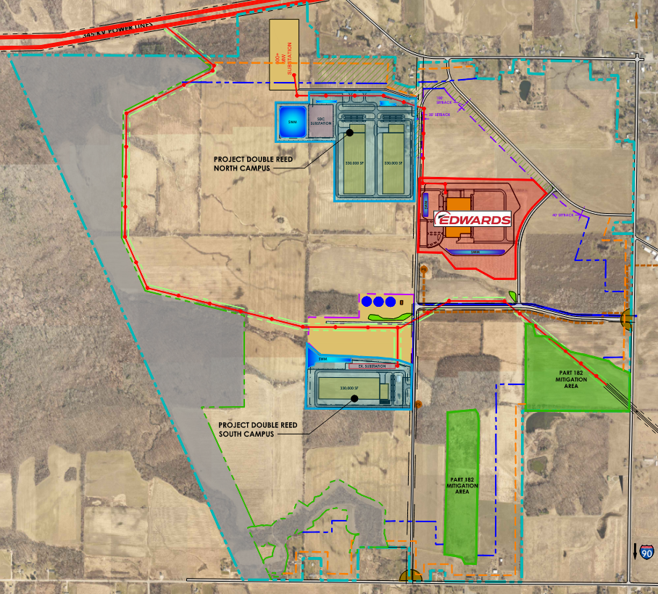
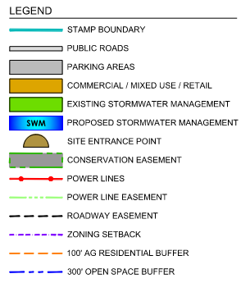
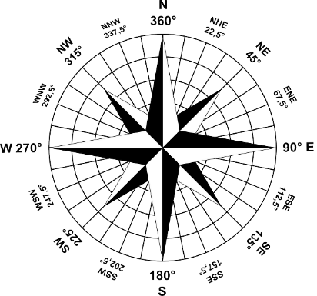
Model Parameters
Model Geometry – STAMP Site Plan View
Section
2
North Site Model
South Site Model

Slide 10
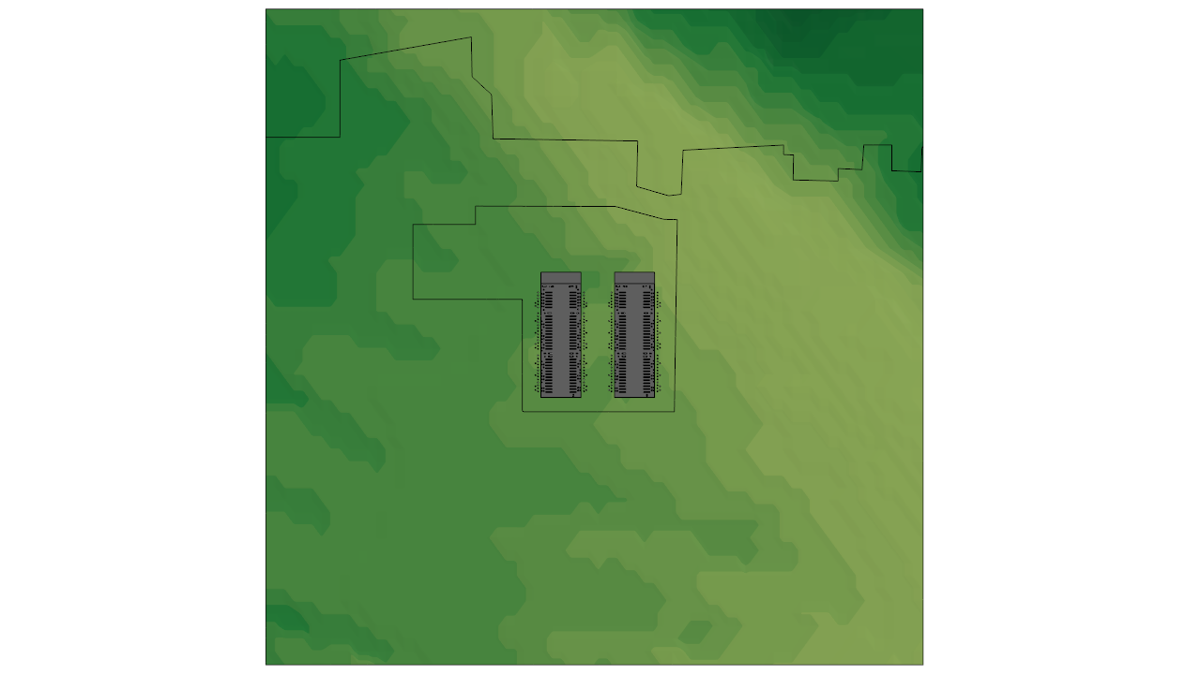
Model Parameters
Model Geometry – North Site Plan View
Section
2
STAMP Perimeter
North Site Perimeter
Aerial View of North Site CFD Model Domain

Slide 11
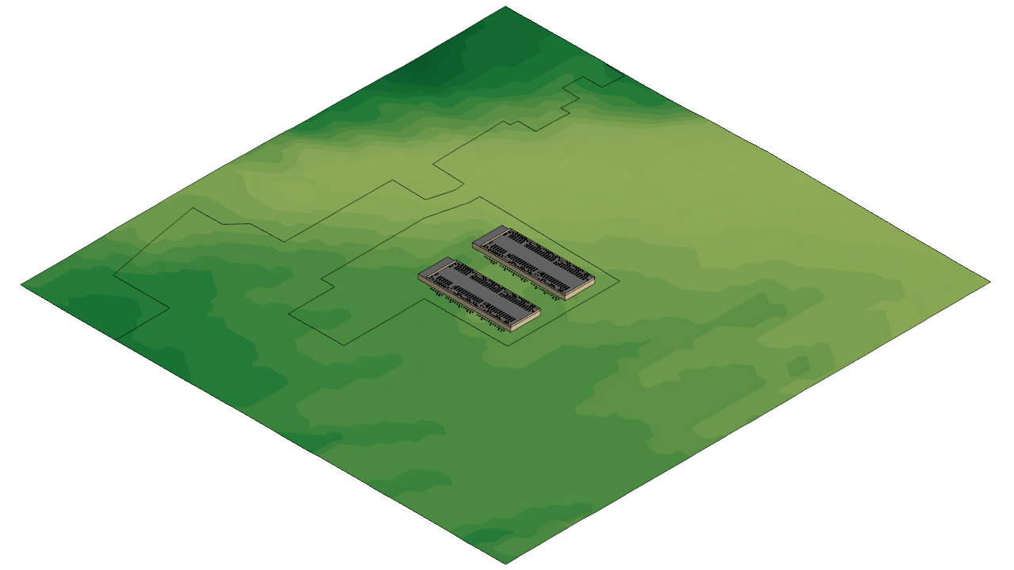
Model Parameters
Model Geometry – North Site Isometric View
Section
2
Isometric View of North Site CFD Model Domain

Slide 12
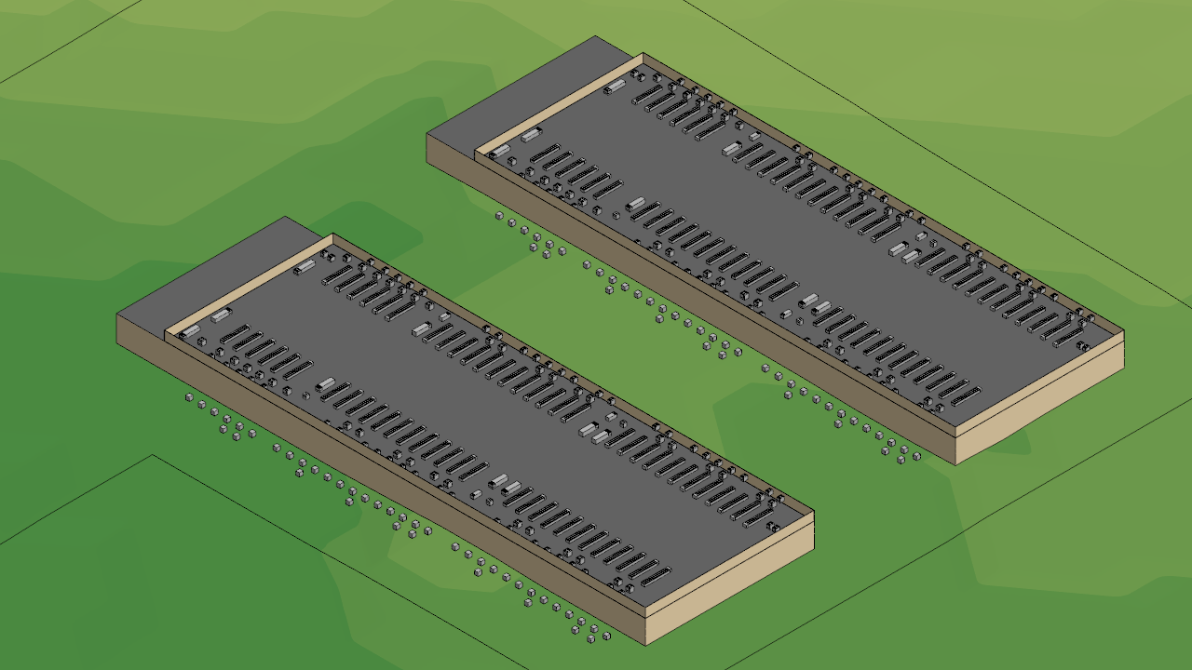
Model Parameters
Model Geometry – North Site Isometric View (Close)
Section
2
Isometric View of North Site CFD Model Domain

Slide 13
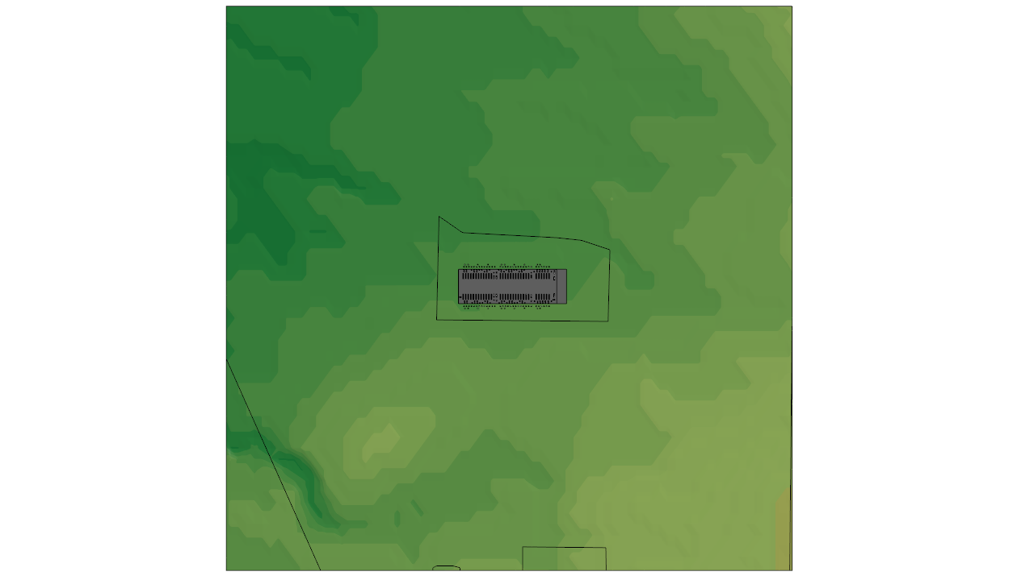
Model Parameters
Model Geometry – South Site Plan View
Section
2
South Site Perimeter
STAMP Perimeter
Aerial View of South Site CFD Model Domain

Slide 14
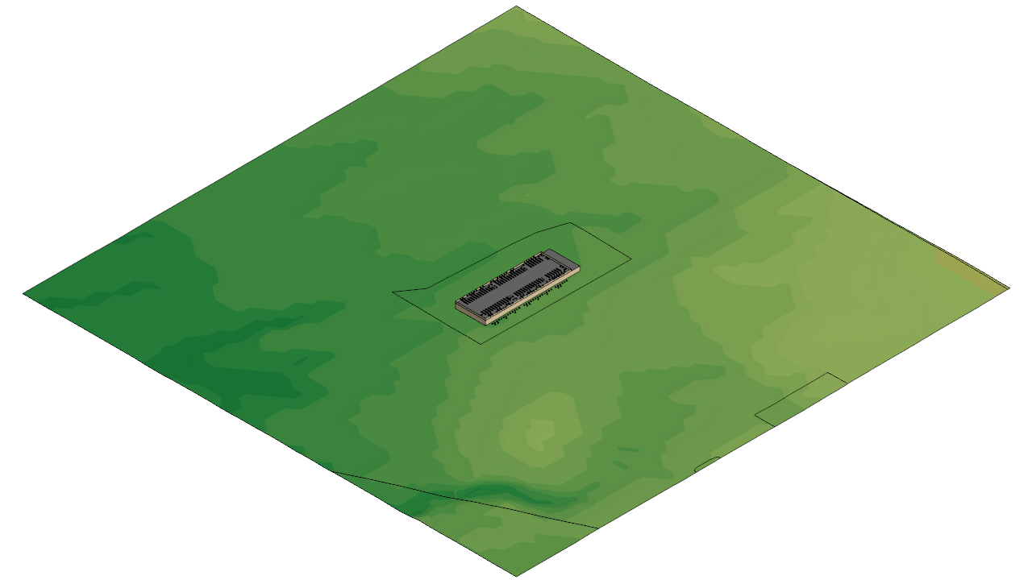
Model Parameters
Model Geometry – South Site Isometric View
Section
2
Isometric View of South Site CFD Model Domain

Slide 15
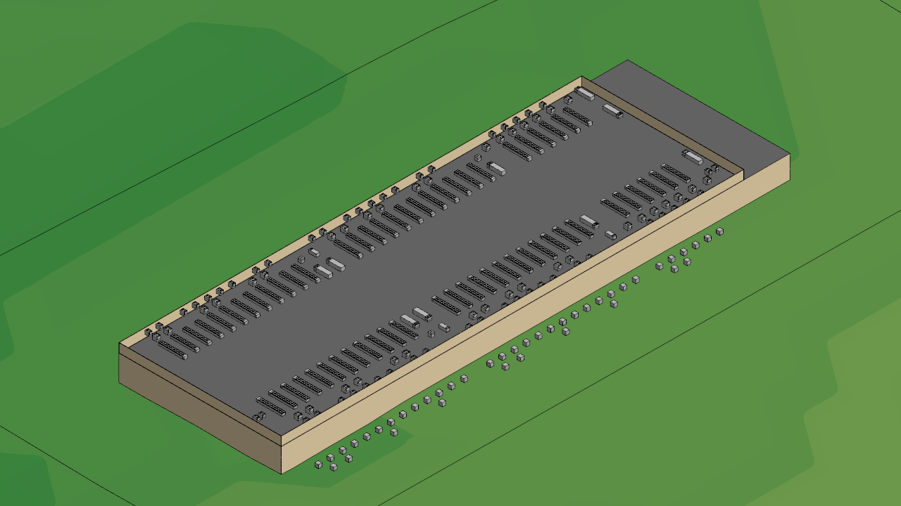
Model Parameters
Model Geometry – South Site Isometric View (Close)
Section
2
Isometric View of South Site CFD Model Domain

Slide 16
Model Parameters
Model Geometry – Additional Notes
Section
2
Since the modeled region is largely composed of farmland and is only minorly forested, as a conservative estimate, no trees or flora of any kind are included in the model
  It is expected that trees and other plants would either absorb heat away from the plume or induce additional turbulence which would cause enhanced mixing of the plume with the ambient air – thereby reducing its temperature
The radiant effect of direct sunlight is not explicitly modeled but its major effects are captured by assigning static surface temperatures to walls, roofs, and the terrain surrounding either site
  The bulk grassy terrain and all walls are held at the ambient temperature of 87.2 °F while the rooftops and area directly adjacent to the facilities comprising the full site area is held at an elevated temperature of 93.2 °F

Slide 17
Model Parameters
Mechanical Information – Equipment Set
Section
2
The data centers are served by a set of typical mechanical equipment including air cooled chillers, dedicated outside air systems (DOAS), rooftop units (RTUs), condensing units (CUs), and transformers
  Each of the three data center facilities are served by identical mechanical layouts comprised by the following typical unit counts per building:
    Chillers: 60 units
    DOAS: 6 units with two design variations
    RTUs: 9 units with four design variations
    CUs: 88 units with two design variations
    Transformers: 84 units
Although the site includes emergency propane generators, these units are for life-safety emergencies only and so only one unit is provided to serve each data center
  These units are not included in the model since they are intended only for life safety emergencies and will therefore not operate during typical conditions, except for regular monthly testing and maintenance, such that their inclusion within the model is not expected to result in any significant deviation from the expected typical plume dispersion as reported
The explicitly modeled mechanical parameters of each unit are described in a following slide titled “Exhaust Temperature Calculation”
To reasonably simplify the computational model, the typical equipment geometry is simplified to focus only on their most important features
  A selection of images describing the simplified geometry can be found on the following slides, along with an example plan view of a typical data center rooftop

Slide 18



Model Parameters
Mechanical Information – Equipment Set 1
Section
2
CU 110kW
Chiller
CU 50kW
The undercarriage geometry of the chiller is not explicitly modeled but the air intake surface along the bottom side is maintained
Note: GREEN surfaces represent the modeled exhaust air locations while RED surfaces represent modeled intake air locations

Slide 19

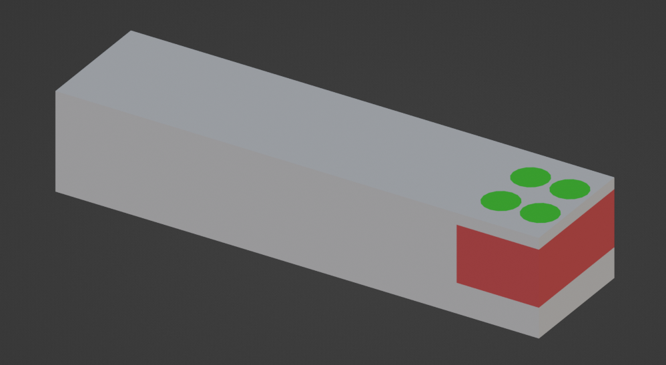

Model Parameters
Mechanical Information – Equipment Set 2
Section
2
RTU-01/05/06
RTU-1A/2A
RTU-02/03/04
Note: GREEN surfaces represent the modeled exhaust air locations while RED surfaces represent modeled intake air locations

Slide 20
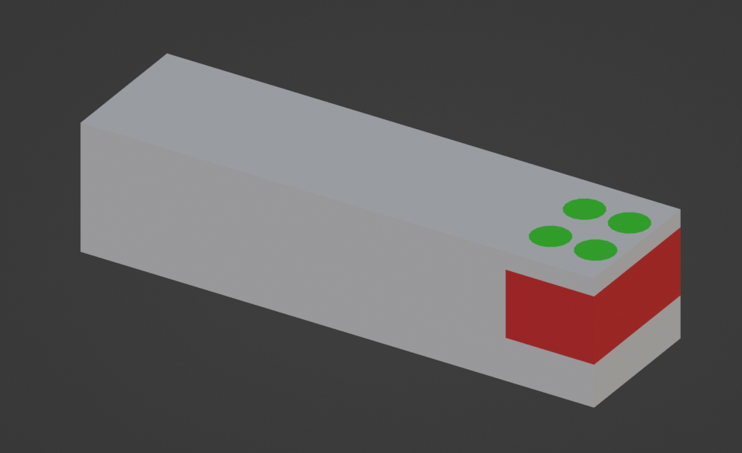
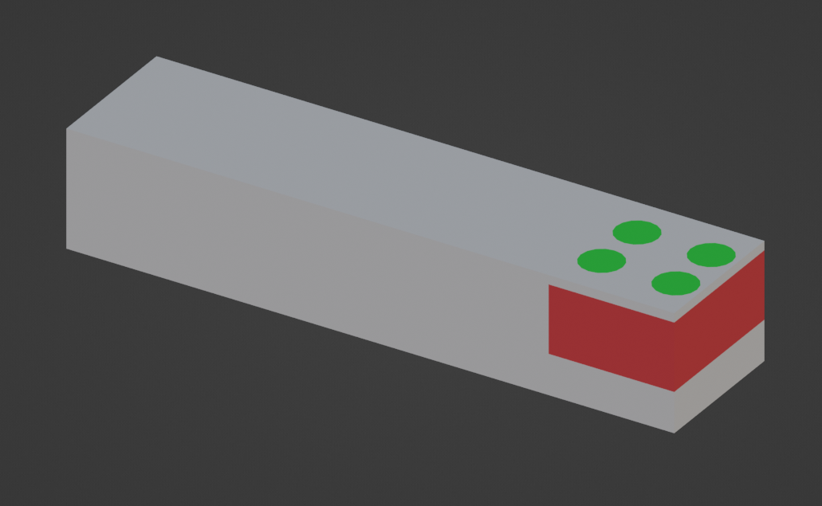

Model Parameters
Mechanical Information – Equipment Set 3
Section
2
DOAS
RTU-3A
Transformer
Note: GREEN surfaces represent the modeled exhaust air locations while RED surfaces represent modeled intake air locations

Slide 21
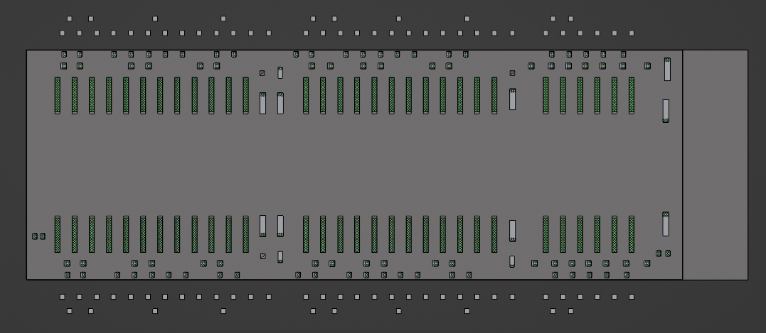
Model Parameters
Mechanical Information – Typical Equipment Rooftop Layout Plan
Section
2
Note: GREEN surfaces represent the modeled exhaust air locations

Slide 22
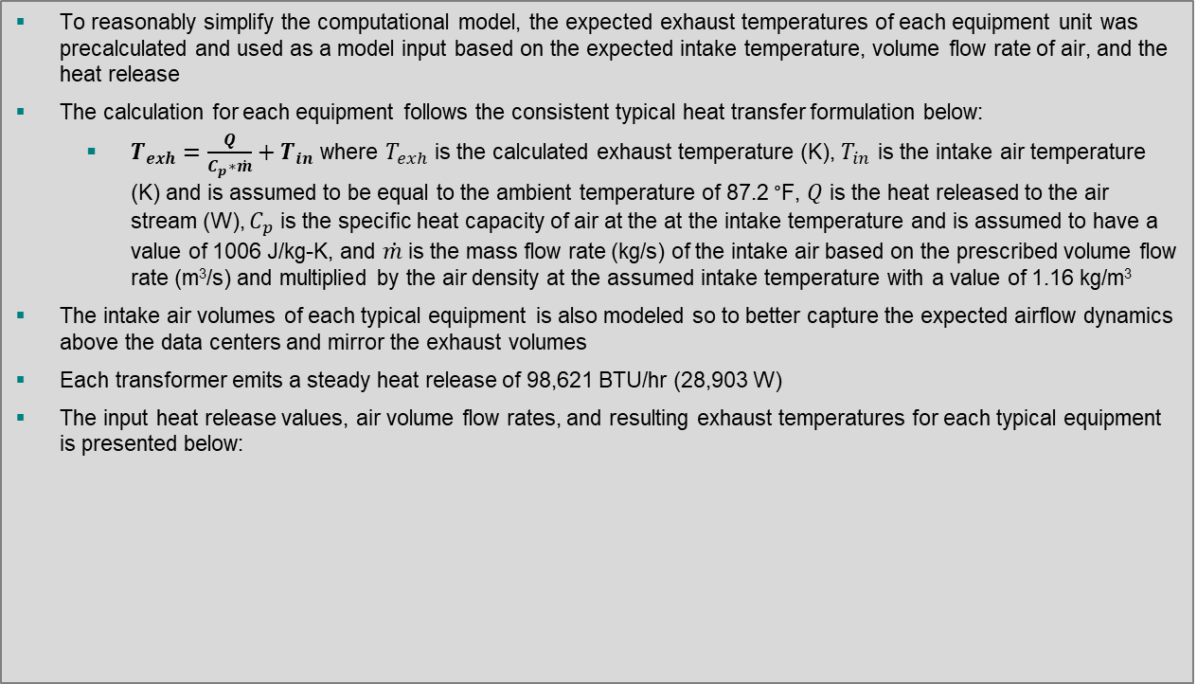
Model Parameters
Mechanical Information – Exhaust Temperature Calculation
Section
2
To reasonably simplify the computational model, the expected exhaust temperatures of each equipment unit was precalculated and used as a model input based on the expected intake temperature, volume flow rate of air, and the heat release
The calculation for each equipment follows the consistent typical heat transfer formulation below:
  $T_{exh}=\frac{Q}{C_{p}∗\dot{m}}+T_{in}$ where $T_{exh}$ is the calculated exhaust temperature (K), $T_{in}$ is the intake air temperature (K) and is assumed to be equal to the ambient temperature of 87.2 °F, $Q$ is the heat released to the air stream (W), $C_{p}$ is the specific heat capacity of air at the at the intake temperature and is assumed to have a value of 1006 J/kg-K, and $\dot{m}$ is the mass flow rate (kg/s) of the intake air based on the prescribed volume flow rate (m³/s) and multiplied by the air density at the assumed intake temperature with a value of 1.16 kg/m³
The intake air volumes of each typical equipment is also modeled so to better capture the expected airflow dynamics above the data centers and mirror the exhaust volumes
Each transformer emits a steady heat release of 98,621 BTU/hr (28,903 W)
The input heat release values, air volume flow rates, and resulting exhaust temperatures for each typical equipment is presented below:
Unit | Heat Release (BTU/hr) | Volume Flow Rate (ft³/min) | Calculated Exhaust Temperature (F)
DOAS 1/2 | 307,648 | 16,600 | 104.9
DOAS 3-6 | 334,324 | 16,600 | 106.5
RTU-1A | 295,080 | 16,600 | 104.2
RTU-2A | 297,710 | 16,600 | 104.3
RTU-3A | 420,109 | 16,600 | 111.4
RTU-01/05/06 | 187,233 | 12,000 | 102.1
RTU-02/03/04 | 194,874 | 12,000 | 102.7
Chiller | 8,100,000 | 458,853 | 104.1
CU 110 kW | 423,400 | 28,632 | 101.3
CU 50 kW | 255,020 | 14,100 | 104.5

Slide 23
Case Study
Base Case – North Site
Section
3
Base Case – North Site: Evaluation of heated exhaust released from two data centers under atypical ambient conditions
    Objective: Determine the expected transient behavior of heated exhaust air from a series of typical equipment serving two large data centers located at the northern site within the STAMP site
    The migration of the exhaust plumes are affected by atypical ambient conditions comprising an ambient temperature of 87.2 °F with a wind speed of 10 mph from varying directions in a full 360° arc centered around the facilities

Slide 24
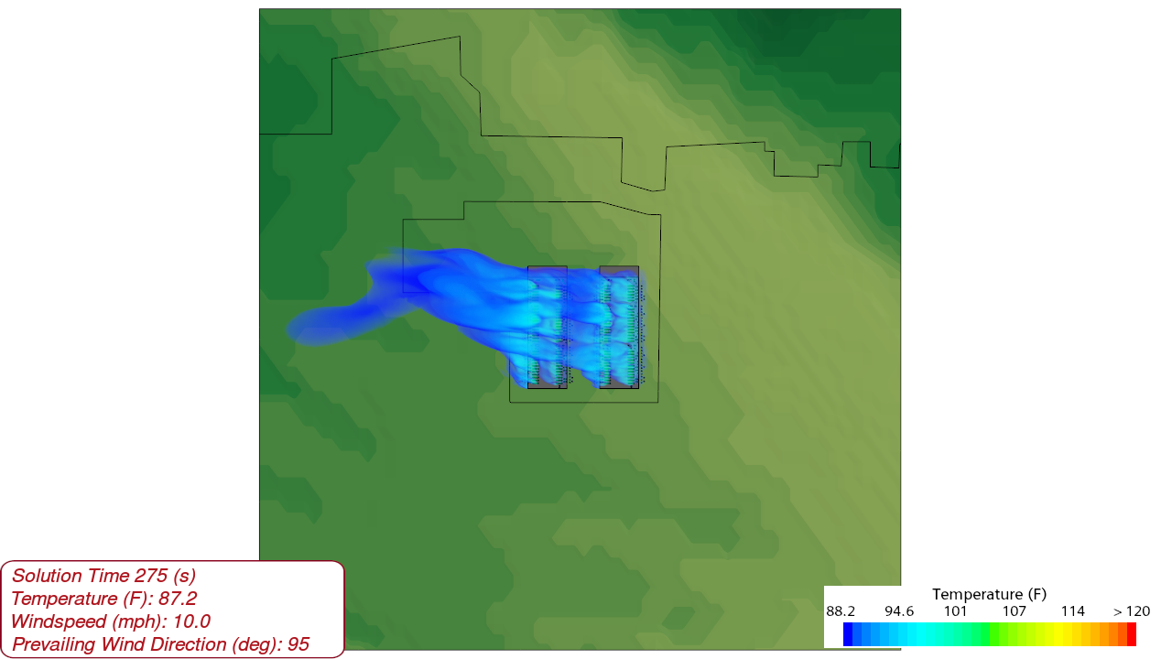
Base Case – North Site
Plan View
Section
3
Note: The extended plumes seen in the first few animation frames are due to a pre-calculated approximate solution used to seed the model initial conditions
24

Slide 25
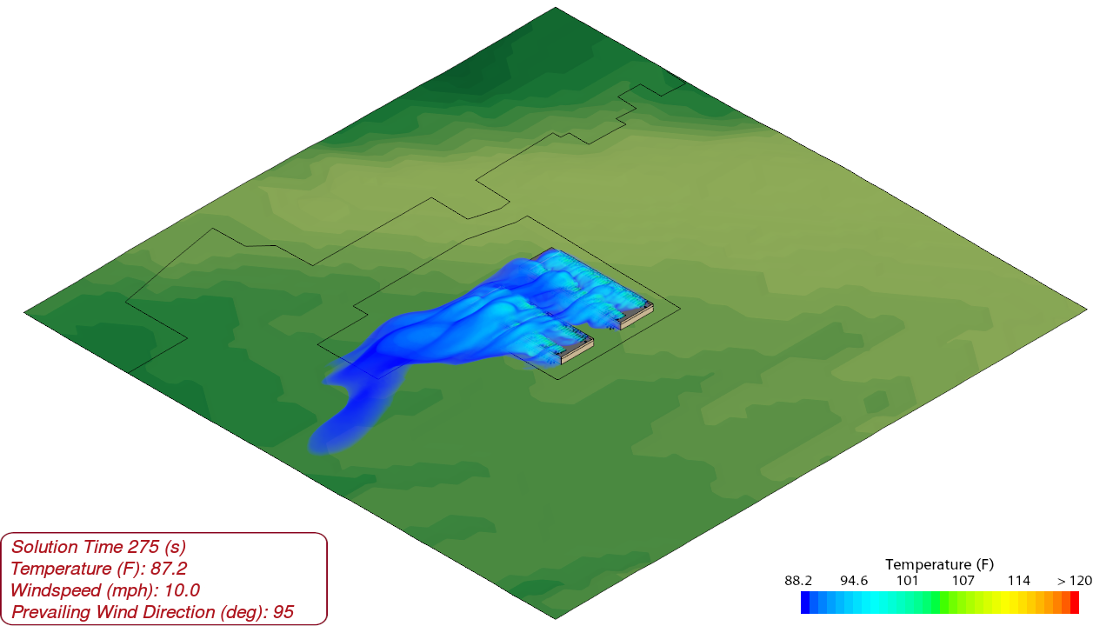
Base Case – North Site
Isometric View
Section
3
Note: The extended plumes seen in the first few animation frames are due to a pre-calculated approximate solution used to seed the model initial conditions
25

Slide 26
Case Study
Base Case – South Site
Section
3
Base Case – South Site: Evaluation of heated exhaust released from a data center under atypical ambient conditions
    Objective: Determine the expected transient behavior of heated exhaust air from a series of typical equipment serving a large data center located at the southern site within the STAMP site
    The migration of the exhaust plumes are affected by atypical ambient conditions comprising an ambient temperature of 87.2 °F with a wind speed of 10 mph from varying directions in a full 360° arc centered around the facility

Slide 27
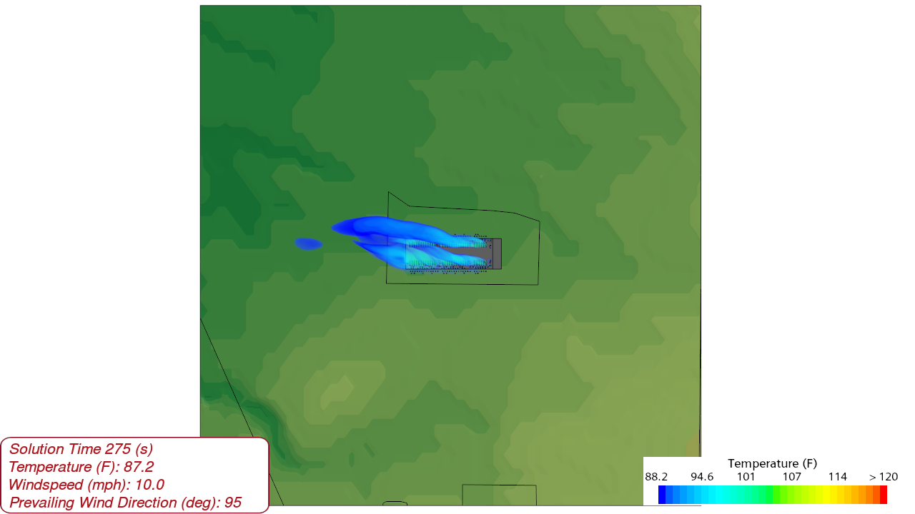
Base Case – South Site
Plan View
Section
3
Note: The extended plumes seen in the first few animation frames are due to a pre-calculated approximate solution used to seed the model initial conditions
27

Slide 28
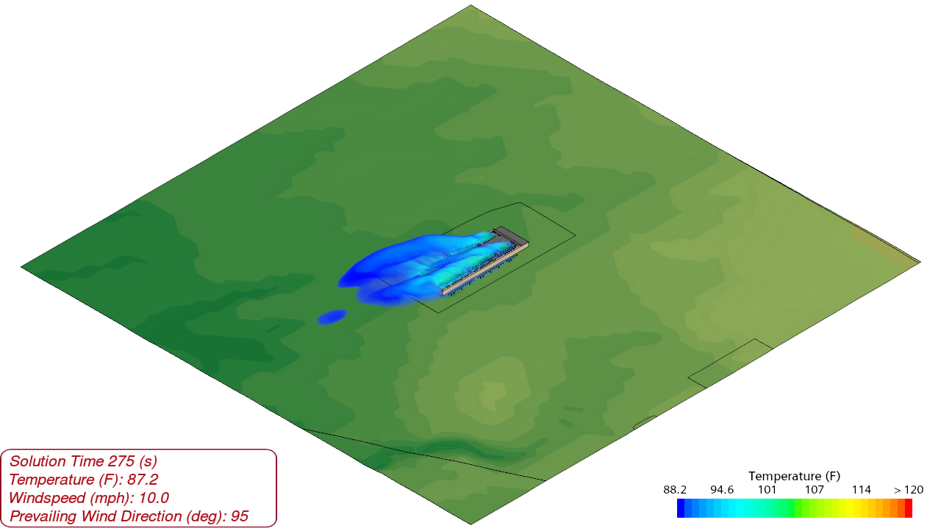
Base Case – South Site
Isometric View
Section
3
Note: The extended plumes seen in the first few animation frames are due to a pre-calculated approximate solution used to seed the model initial conditions
28

Slide 29
Analysis & Conclusions
Section
4
Analysis & Conclusions:
The intent of the study is to assess the expected distribution of air temperatures surrounding the Project Double Reed sites due to concern that the heated air exhausted from the rooftop equipment may potentially adversely effect nearby environmental conditions
  This CFD simulation describes the steady operation of heat generating equipment serving two large data center sites, comprising a total of three facilities
    The typical equipment for each building is comprised by 60 air-cooled chillers, 6 DOAS units, 9 RTUs, 88 condensing units, and 84 transformers
    The emergency propane generators are not included in the model as they serve only as life-safety emergency systems and will not be used during normal operating conditions except for regular testing and maintenance, such that their inclusion within the model is not expected to result in any significant deviation from the expected typical plume dispersion as reported
To reasonably simplify the computational model, the STAMP site was split into two separate 1 sq mile domains
  The distance between the Project Double Reed sites is approximately 0.5 miles and so the exhaust plumes are not expected to positively compound with one another across the two sites
As a reasonable “worst-case” scenario, the simulated ambient temperature is set to be 87.2 °F which aligns with the equipment sizing design condition and exceeds the ASHRAE 99.6% cooling design condition of 86.6 °F as measured from the nearby Buffalo Niagara International Airport
Analysis and Conclusions continued on to following slide…

Slide 30
Analysis & Conclusions
Section
4
Analysis & Conclusions (Continued):
A wind speed of 10 mph was simulated based on wind condition data measured from the Genesee County Airport which is located nearby in Batavia, NY
  This wind speed was selected from typical July wind conditions as July is the month with typically the highest average temperatures
  A wind speed of 10 mph is modeled instead of the average wind speed of 7.4 mph to partially account for wind gusts
  The wind was indexed at 30° increments around each site, comprising a full 360° arc, from 5° to 335°
The animated plume dynamics from each site describe that the ambient air temperatures at both ground level and at approximately 50 ft above grade may rise above approximately 1 °F only in the vicinity immediately adjacent to the facilities
  However, this effect is highly localized and drops off substantially with distance from either site such that it is not expected to materially effect the environmental conditions around the facility sites themselves and therefore is also not expected to adversely affect environmental conditions outside of the STAMP site
  It was also noted that there is a parcel of land at the north side of the STAMP site which interrupts the typical site perimeter and so is located relatively nearer to the north Project Double Reed site than other property locations
    The animated plume dynamics of the north site appear to indicate that the northern parcel may experience above ambient temperature exhaust but the visualized plume is well elevated into the atmosphere due to its buoyancy such that this property is not expected to sustain a direct impact on environmental conditions at the ground or housing level
      The current results indicate that only slightly above ambient temperature air from the north site facility may periodically sweep over the northern parcel for strong southern prevailing winds

